Slide 1
Real Time Operating Systems for Networked Embedded Systems
Subhashis Banerjee
Indian Institute of Technology
Delhi
suban@cse.iitd.ac.in
With: Soumyadeb Mitra, Nitin Rajput, M.Balakrishnan

Slide 2
Fire alarm system: an example
Central server
TCP/IP over radio
Controllers: ARM based
Low bandwidth radio links
Sensors: microcontroller based

Slide 3
Fire Alarm System
Problem
  Hundreds of sensors, each fitted with Low Range Wireless
    Sensor information to be logged in a server & appropriate action initiated
Possible Solution
  Collaborative Action
    Routing
      Dynamic – Sensors/controllers may go down
      Auto Configurable – No/easy human intervention.
      Less Collision/Link Clogging
      Less no of intermediate nodes
        Fast Response Time
      Secure

Slide 4
RTOS: Target Architectures
Processors MIPS
Microcontrollers ~20
ARM7 100-133
ARM9 180-250
Strong ARM 206
Intel Xscale 400
Mips4Kcore 400
X86

Slide 5
Presentation Outline
Definitions
Role of an OS in Real Time Systems
Features of Real Time Operating Systems
  Scheduling
  Resource Allocation
  Interrupt Handling
  Other Issues
Linux for Real Time Systems and RTLinux
rtker – Our own RTOS
Other RTOS’s

Slide 6
Real Time System
A system is said to be Real Time if it is required to complete it’s work & deliver it’s services on time.
Example – Flight Control System
  All tasks in that system must execute on time.
Non Example – PC system

Slide 7
Hard and Soft Real Time Systems
Hard Real Time System
  Failure to meet deadlines is fatal
  example : Flight Control System
Soft Real Time System
  Late completion of jobs is undesirable but not fatal.
  System performance degrades as more & more jobs miss deadlines
  Online Databases
Qualitative Definition.

Slide 8
Hard and Soft Real Time Systems
(Operational Definition)
Hard Real Time System
  Validation by provably correct procedures or extensive simulation that the system always meets the timings constraints
Soft Real Time System
  Demonstration of jobs meeting some statistical constraints suffices.
Example – Multimedia System
  25 frames per second on an average

Slide 9
Role of an OS in Real Time Systems
Standalone Applications
  Often no OS involved
  Micro controller based Embedded Systems
Some Real Time Applications are huge & complex
  Multiple threads
  Complicated Synchronization Requirements
  Filesystem / Network / Windowing support
  OS primitives reduce the software design time

Slide 10
Features of RTOS’s
Scheduling.
Resource Allocation.
Interrupt Handling.
Other issues like kernel size.

Slide 11
Scheduling in RTOS
More information about the tasks are known
  No of tasks
  Resource Requirements
  Release Time
  Execution time
  Deadlines
Being a more deterministic system better scheduling algorithms can be devised.

Slide 12
Scheduling Algorithms in RTOS
Clock Driven Scheduling
Weighted Round Robin Scheduling
Priority Scheduling
(Greedy / List / Event Driven)

Slide 13
Scheduling Algorithms in RTOS (contd)
Clock Driven
  All parameters about jobs (release time/ execution time/deadline) known in advance.
  Schedule can be computed offline or at some regular time instances.
  Minimal runtime overhead.
  Not suitable for many applications.

Slide 14
Scheduling Algorithms in RTOS (contd)
Weighted Round Robin
  Jobs scheduled in FIFO manner
  Time quantum given to jobs is proportional to it’s weight
  Example use : High speed switching network
    QOS guarantee.
  Not suitable for precedence constrained jobs.
    Job A can run only after Job B. No point in giving time quantum to Job B before Job A.

Slide 15
Scheduling Algorithms in RTOS (contd)
Priority Scheduling
(Greedy/List/Event Driven)
  Processor never left idle when there are ready tasks
  Processor allocated to processes according to priorities
  Priorities
    static - at design time
    Dynamic - at runtime

Slide 16
Priority Scheduling
Earliest Deadline First (EDF)
  Process with earliest deadline given highest priority
Least Slack Time First (LSF)
  slack = relative deadline – execution left
Rate Monotonic Scheduling (RMS)
  For periodic tasks
  Tasks priority inversely proportional to it’s period

Slide 17
Resource Allocation in RTOS
Resource Allocation
  The issues with scheduling applicable here.
  Resources can be allocated in
    Weighted Round Robin
    Priority Based
Some resources are non preemptible
  Example : semaphores
Priority Inversion if priority scheduling is used

Slide 18
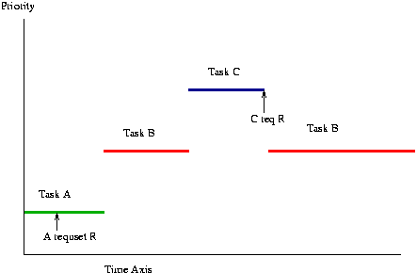
Priority Inversion

Slide 19
Solutions to Priority Inversion
Non Blocking Critical Section
  Higher priority Thread may get blocked by unrelated low priority thread
Priority Ceiling
  Each resource has an assigned priority
  Priority of thread is the highest of all priorities of the resources it’s holding
Priority Inheritance
  The thread holding a resource inherits the priority of the thread blocked on that resource

Slide 20
Other RTOS issues
Interrupt Latency should be very small
  Kernel has to respond to real time events
  Interrupts should be disabled for minimum possible time
For embedded applications Kernel Size should be small
  Should fit in ROM
Sophisticated features can be removed
  No Virtual Memory
  No Protection

Slide 21
Linux for Real Time Applications
Scheduling
  Priority Driven Approach
    Optimize average case response time
  Interactive Processes Given Highest Priority
    Aim to reduce response times of processes
  Real Time Processes
    Processes with high priority
    No notion of deadlines
Resource Allocation
  No support for handling priority inversion

Slide 22
Interrupt Handling in Linux
Interrupts are disabled in ISR/critical sections of the kernel
No worst case bound on interrupt latency avaliable
  eg: Disk Drivers may disable interrupt for few hundred milliseconds
Not suitable for Real Time Applications
  Interrupts may be missed

Slide 23
Other Problems with Linux
Processes are non preemtible in Kernel Mode
  System calls like fork take a lot of time
  High priority thread might wait for a low priority thread to complete it’s system call
Processes are heavy weight
  Context switch takes several hundred microseconds

Slide 24
Why Linux
Coexistence of Real Time Applications with non Real Time Ones
  Example http server
Device Driver Base
Stability

Slide 25
RTLinux
Real Time Kernel at the lowest level
Linux Kernel is a low priority thread
  Executed only when no real time tasks
Interrupts trapped by the Real Time Kernel and passed onto Linux Kernel
  Software emulation to hardware interrupts
    Interrupts are queued by RTLinux
    Software emulation to disable_interrupt()

Slide 26
RTLinux (contd)
Real Time Tasks
  Statically allocate memory
  No address space protection
Non Real Time Tasks are developed in Linux
Communication
  Queues
  Shared memory

Slide 27
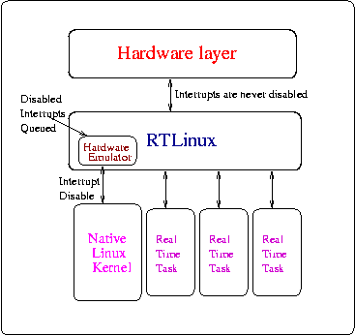
RTLinux Framework

Slide 28
rtker – Our RTOS
Motivation
  Our own OS
    Full grasp over source code – Easily modifiable, portable
Features
  Modular Design
    Isolation of Architecture/CPU dependent and independent code – Easy to Port
  Pluggable Scheduler
  Two level Interrupt Handling
  Small footprint
  Oskit’s Device Driver Framework

Slide 29
Pluggable Scheduler
Scheduler - part of the Application
Kernel interacts with the scheduler through an API
Application developer needs to implement the scheduler API
  Can optimize on Data Structures & Algorithms for implementing the scheduler

Slide 30
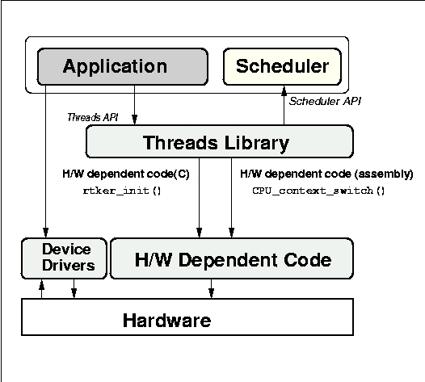
rtker – Block Diagram

Slide 31
Two Level Interrupt Handling
Two level Interrupt Handling
  Top Half Interrupt Handler
    Called Immediately – Kernel never disables interrupts
    Cannot invoke thread library functions - Race Conditions
  Bottom Half Interrupt Handler
    Invoked when kernel not in Critical Section
    Can invoke thread library functions
Very Low Response time (as compared to Linux)

Slide 32
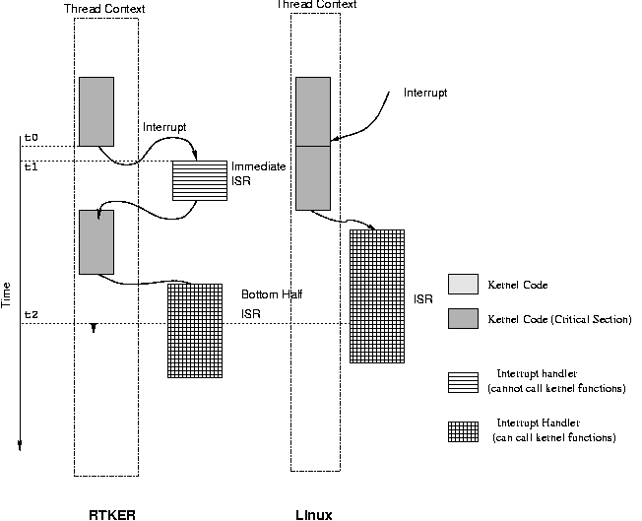
Two Level Interrupt Handling

Slide 33
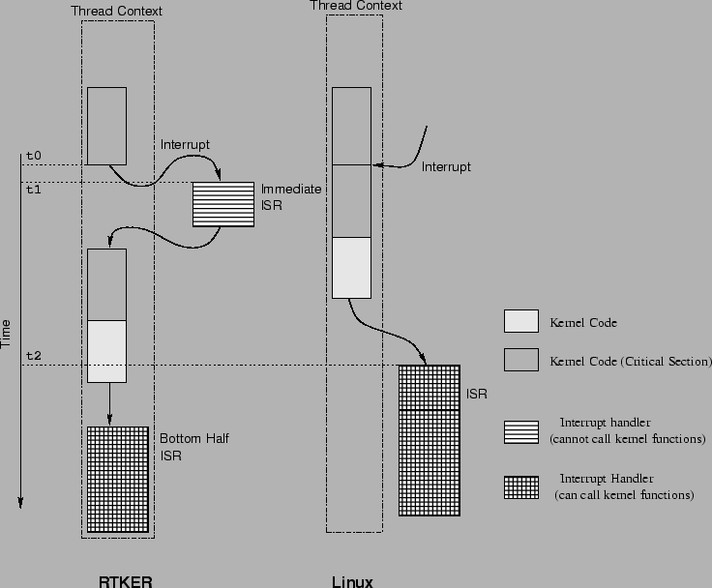

Slide 34
Other Features
Footprint
  Small footprint (~50kb)
Oskit’s Device Driver Framework
  Allows direct porting of existing drivers from Linux.
  Example – Ethernet Driver of Linux

Slide 35
Other RTOS’s
LynxOS
  Microkernel Architecture
    Kernel provides scheduling/interrupt handling
  Additional features through Kernel Plug Ins(KPIs)
    TCP/IP stack , Filesystem
    KPI’s are multithreaded
  Memory Protection/ Demand Paging Optional
  Development and Deployment on the same host
    OS support for compilers/debuggers

Slide 36
Other RTOS’s (contd)
VxWorks
  Monolithic Architecture
  Real Time Posix compliant
  Cross development System
pSOS
  Object Oriented OS

Slide 37
Peripheral devices and protocols
Interfacing
Serial/parallel ports, USB, I2C, PCMCIA, IDE
Communication
Serial, Ethernet, Low bandwidth radio, IrDA,
802.11b based devices
User Interface
LCD, Keyboard, Touch sensors, Sound, Digital
pads, Webcams
Sensors
A variety of sensors using fire, temperature,
pressure, water level, seismic, sound, vision

